Slide 1

Vežba 6
I princip termodinamike
Termodinamika sa termotehnikom

Slide 2
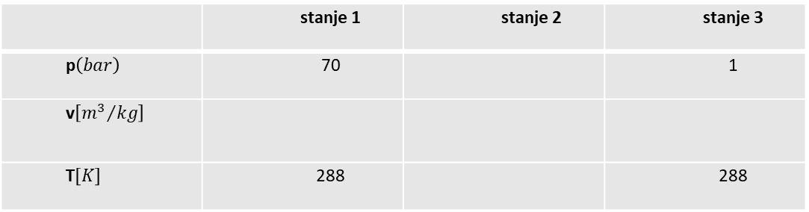
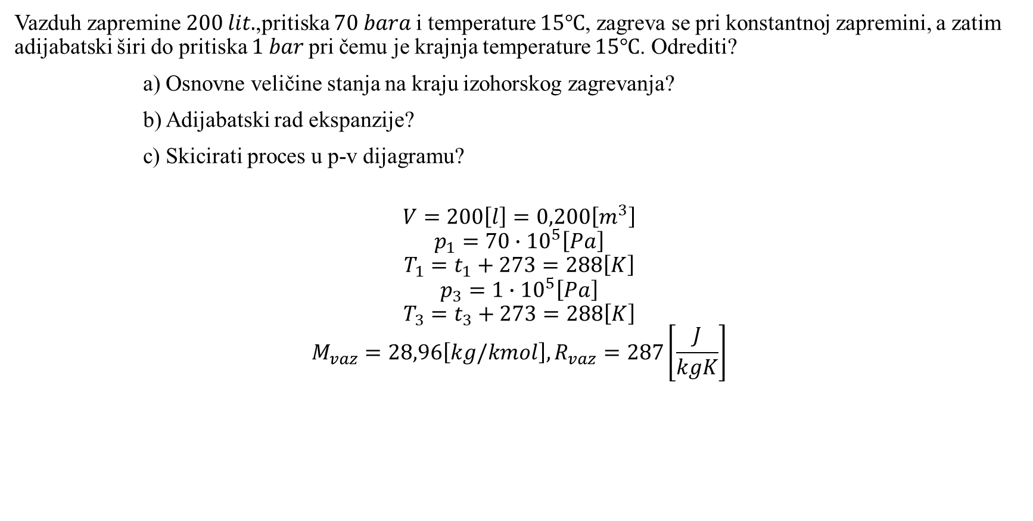
Vazduh zapremine 200 𝑙𝑖𝑡.,pritiska 70 𝑏𝑎𝑟𝑎 i temperature 15℃, zagreva se pri konstantnoj zapremini, a zatim adijabatski širi do pritiska 1 𝑏𝑎𝑟 pri čemu je krajnja temperature 15℃. Odrediti?
a) Osnovne veličine stanja na kraju izohorskog zagrevanja?
b) Adijabatski rad ekspanzije?
c) Skicirati proces u p-v dijagramu?
$$V=200\left[l\right]=0,200\left[m^{3}\right]$$
$$p_{1}=70∙{10}^{5}\left[Pa\right]$$
$$T_{1}=t_{1}+273=288\left[K\right]$$
$$p_{3}=1∙{10}^{5}\left[Pa\right]$$
$$T_{3}=t_{3}+273=288\left[K\right]$$
$$M_{vaz}=28,96\left[kg/kmol\right], R_{vaz}=287\left[\frac{J}{kgK}\right]$$
 | stanje 1 | stanje 2 | stanje 3
p$\left(bar\right)$ | 70 |  | 1
v$\left[{m^{3}}/{kg}\right]$
T$\left[K\right]$ | 288 |  | 288

Slide 3
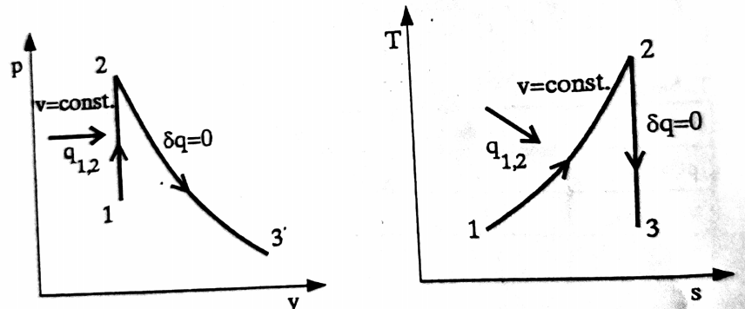

$$p_{1}v_{1}=RT_{1}$$
$${ p}_{3}v_{3}=RT_{3}$$
$$v_{1}=\frac{RT_{1}}{p_{1}}=\frac{8315\left[J/{kmolK}\right]∙\left(15+273\right)\left[K\right]}{28,96\left[{kg}/{kmol}\right]∙70∙{10}^{5}\left[Pa\right]}=0,012\left[{m^{3}}/{kg}\right]$$
$$v_{3}=\frac{8315\left[J/{kmolK}\right]∙\left(15+273\right)\left[K\right]}{28,96\left[{kg}/{kmol}\right]∙1∙{10}^{5}\left[Pa\right]}=0,826\left[{m^{3}}/{kg}\right]$$

Slide 4

$$p_{2}{v_{2}}^{x}=p_{3}{v_{3}}^{x}$$
$$p_{2}=p_{3}{\left(\frac{v_{3}}{v_{2}}\right)}^{x}=1\left[bar\right]{\left(\frac{0,826}{0,012}\right)}^{1,4}=374\left[bar\right]$$
$$p_{2}^{1−x}{T_{2}}^{x}=p_{3}^{1−x}{T_{3}}^{x}$$
$$T_{2}=T_{3}{\left(\frac{p_{3}}{p_{2}}\right)}^{\frac{1−x}{x}}=\left(15+273\right)\left[K\right]{\left(\frac{1}{374}\right)}^{\frac{1−1,4}{1,4}}=1565\left[K\right]$$
$$Q_{1,2}=mc_{v}\left(t_{2}−t_{1}\right)$$
$$m=\frac{p_{1}∙V_{1}}{RT_{1}}=\frac{70∙{10}^{5}\left[Pa\right]∙200∙{10}^{−3}\left[{m^{3}}_{N}\right]∙28,96\left[{kg}/{kmol}\right]}{8315\left[J/{kmolK}\right]∙288\left[K\right]}=16,93\left[kg\right]$$
$$Q_{1,2}=16,93\left[kg\right]\frac{20,8\left[J/{kmolK}\right]}{28,96\left[{kg}/{kmol}\right]}\left(1565−\left(15+273\right)\right)=15528\left[kJ\right]$$

Slide 5
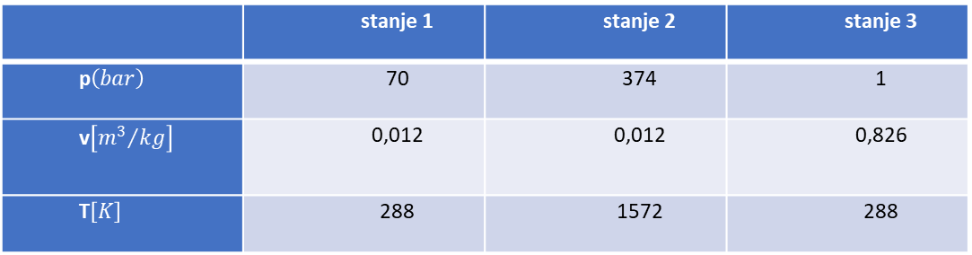

$$W_{2,3}=\frac{mR}{x−1}\left(T_{2}−T_{3}\right)$$
$$W_{2,3}=16,93\left[kg\right]\frac{8315\left[J/{kmolK}\right]}{28,96\left[{kg}/{kmol}\right]∙\left(1,4−1\right)}\left(1565−288\right)\left[K\right]=15519\left[kJ\right]$$
 | stanje 1 | stanje 2 | stanje 3
p$\left(bar\right)$ | 70 | 374 | 1
v$\left[{m^{3}}/{kg}\right]$ | 0,012 | 0,012 | 0,826
T$\left[K\right]$ | 288 | 1572 | 288

Slide 6
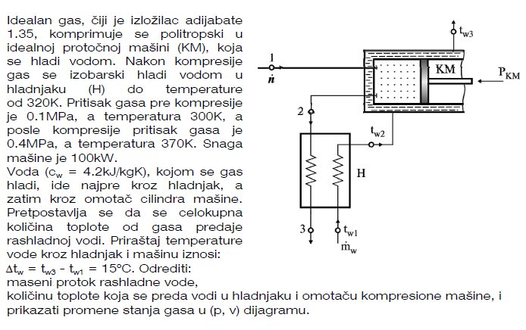

Slide 7
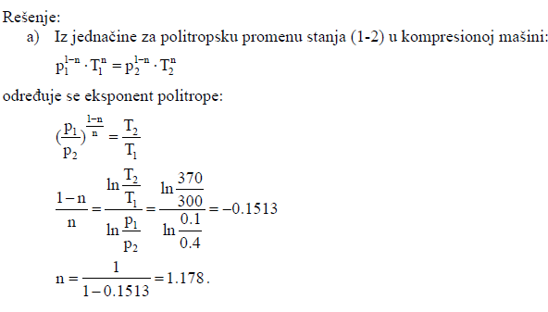
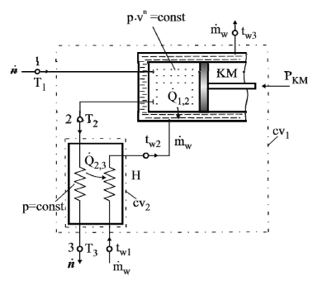

Slide 8
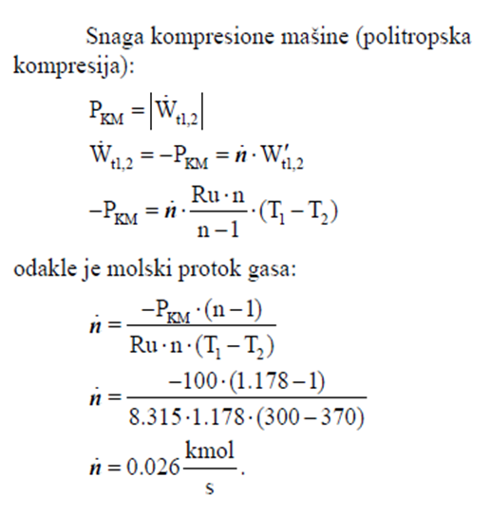
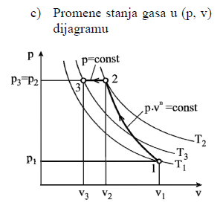

Slide 9
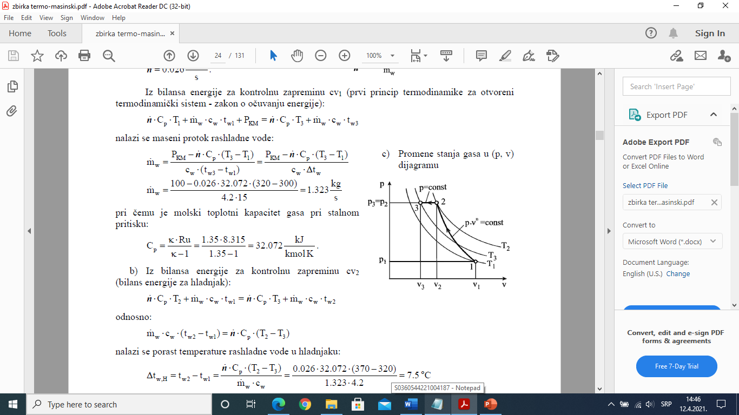

Slide 10
